Slide 1
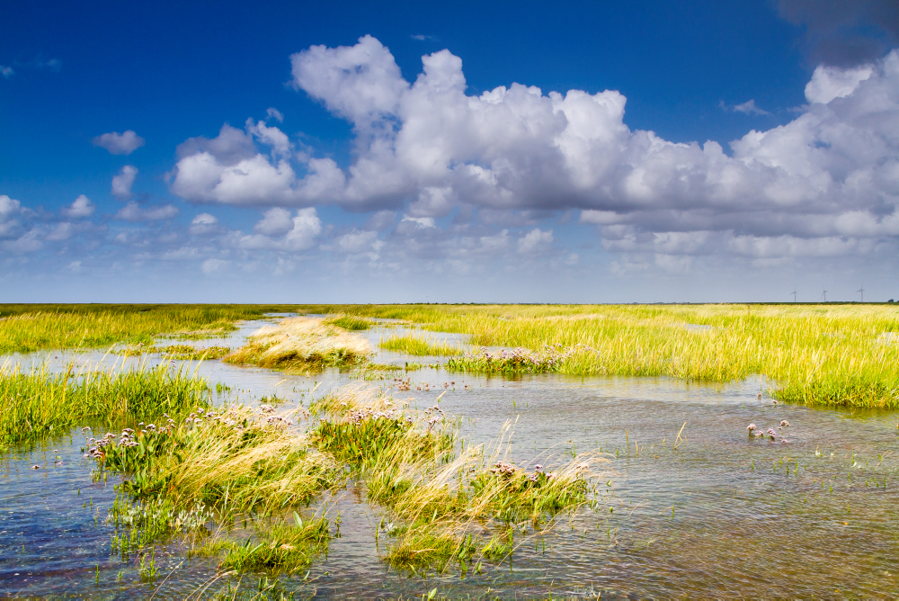



NG ST Meeting| 23. SEPTEMBER 2021 | BÜSUM |
Current projects and activities in Schleswig-Holstein

Slide 2
Current projects and activities in Schleswig-Holstein
WWF (Anja Szczesinski)
  Wadden Sea Explorer
  Tourism Monitor & Video Tutorials
Nordsee-Tourismus-Service (Frank Ketter)
  North Sea Cycle Route – Blogger tour
  North Sea Cycle Route – Marketing aspects
  E-Learning Platform
  The North Sea E-Mobil
National Park Administration (Catharina Greve & Christiane Gätje)
  Study on Regional economic effects of National Park Tourism
  Visitor Survey – update and response numbers
  Residents‘ Survey on Health and wellbeing
  New WH-licensed merchandising product (HH NP Wadden Sea)

Slide 3

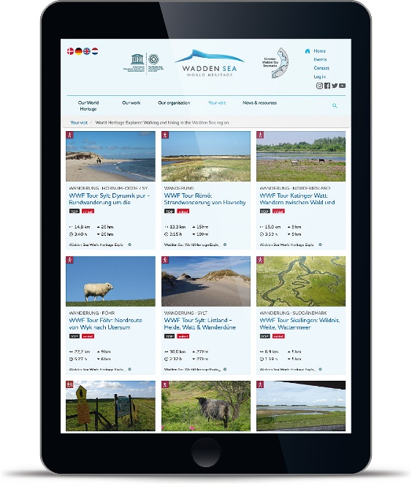
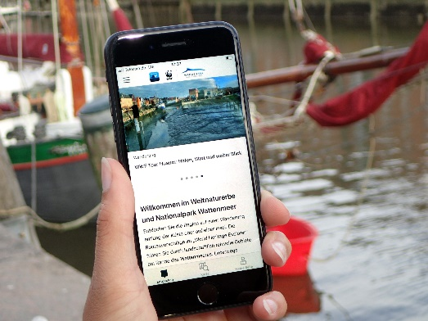
Wadden Sea Explorer
Platform for self-guided hiking tours in the Wadden Sea World Heritage destination
Available online https://www.waddensea-worldheritage.org/explorer and as app
Set-up & first 25 tours within de-dk Interreg project NAKUWA (2017-2020)
Open for expansion to Lower Saxony and the Netherlands
Currently development of common standards to integrate existing Visit Wadden & WaddenAgenda tours and new tours by nature guides, visitor centres, etc.

Slide 4
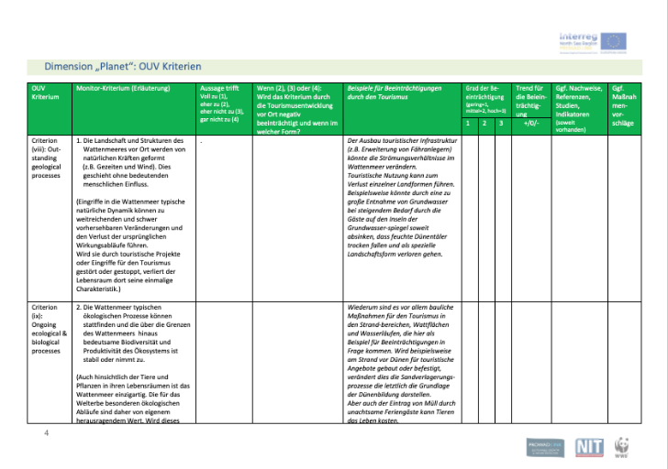
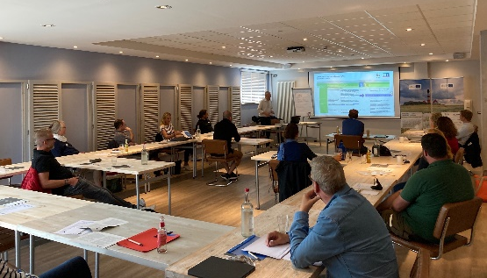
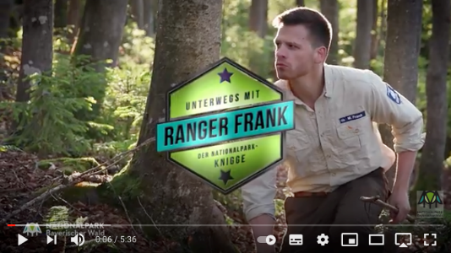
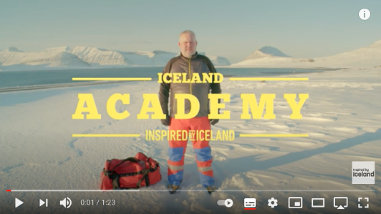
Tourism Value Monitor &
Video Tutorials
How much tourism can the Wadden Sea World Heritage destination carry?
Guidance for self-check for local destinations on influence of tourism on „people - planet - profit“ values
How to prevent „bad visitor behaviour“?
Video tutorials on how to be a good guest in the WSWH destination: framework concept for series of videos; pilot films in Schleswig-Holstein

Slide 5
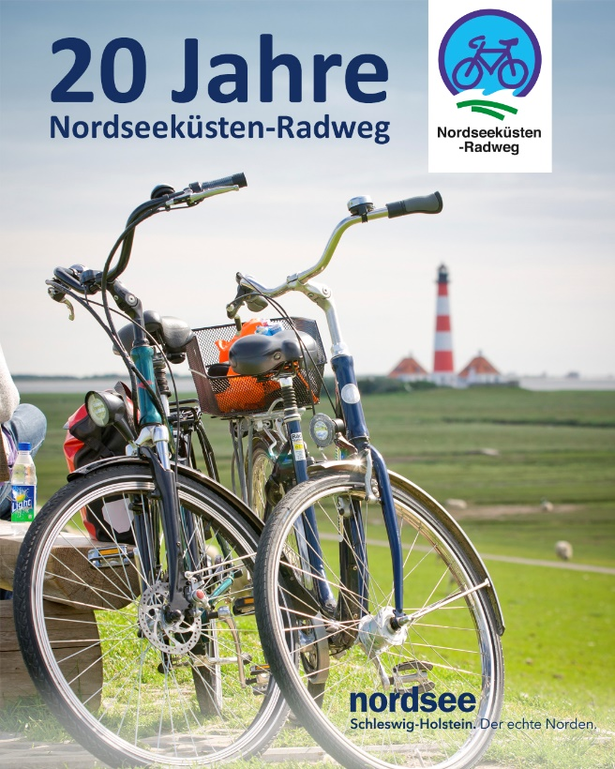
Blogger Tour Juni 2021
On the occasion of the 20th Anniversary of the North Sea Cycle Route, a blogger tour was held
  in co-operation with Die Nordsee GmbH from Lower Saxony
  Timeframe: 14 to 20 Juni 2021
  Pictures of the tour were posted on Facebook and Instagram

Slide 6
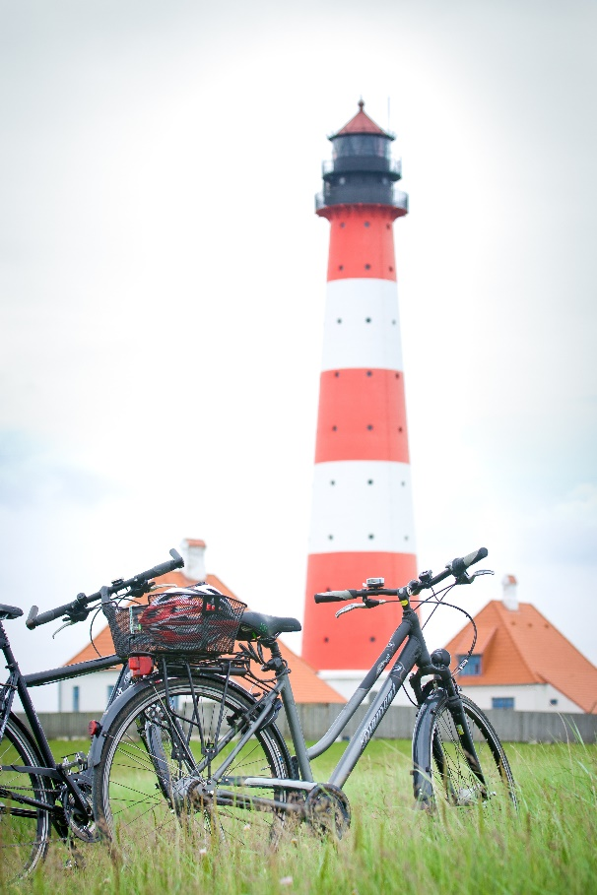
The North Sea Cycle Route Marketing Project
Partners
  Die Nordsee GmbH
  Tourism Association Landkreis Stade/Elbe e.V.
  Holstein Tourism e.V.
  North Sea Tourism Services (NTS)
  Timeframe: October 2021 – December 2023
Aim is to establish a permanent position to coordinate the entire German section of the route
Marketing of a digital platform, translations, photos, flyer, advertising

Slide 7
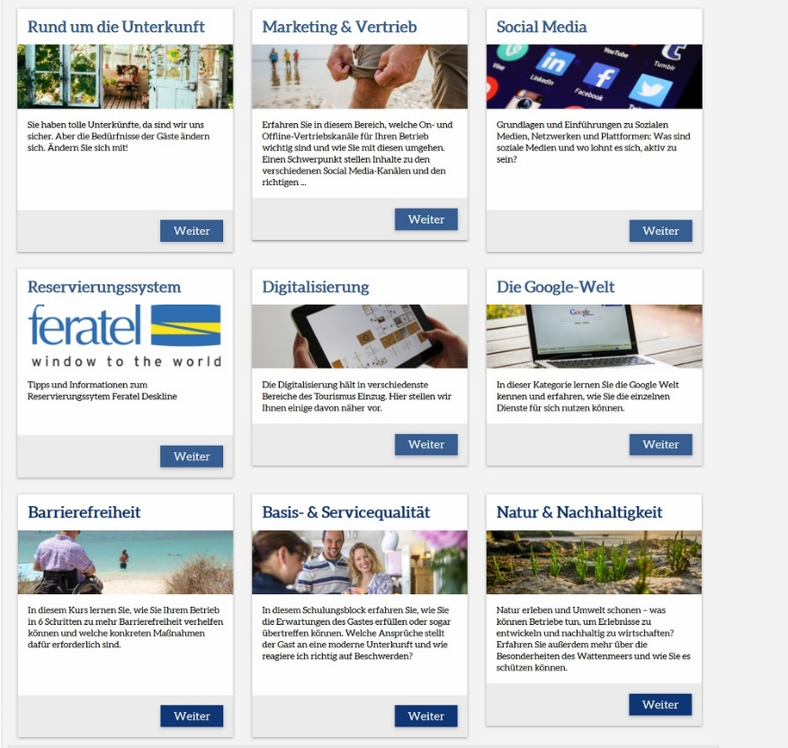
E – Learning Platform
NTS coordinates a joint e-learning platform
Partners are the DMO's (OHT, MakS, SHBT, HLMS)
Each partners pays 100 € per month to NTS for coordination efforts
The goal is to significantly increase the number of registered providers in 2021
Currently there are 13 subject areas with approx. 164 learning units online. Most of these have been purchased by NTS.
Stronger cooperation with other partners in the country.

Slide 8
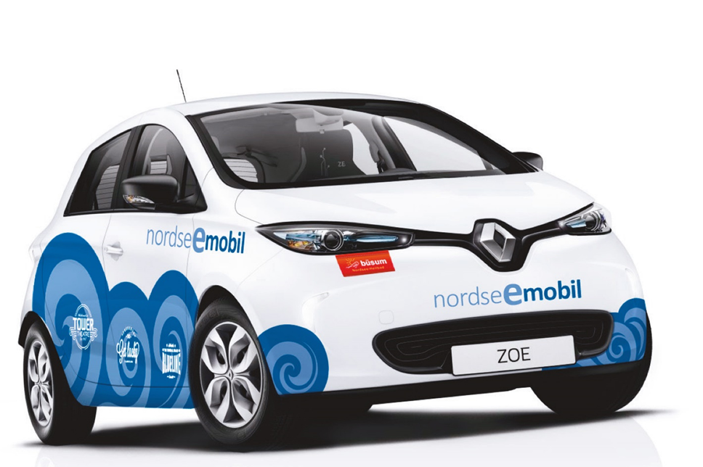
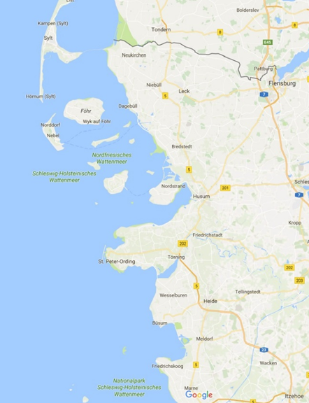
North Sea E-Mobil
Electric cars as a mobility concept
CO² neutral on the road at the Wadden Sea World Heritage Site
Linking two North Frisian industries
Locations are Sylt, Amrum, Langeness, NTS Husum, St. Peter Ording (2 cars), Büsum, Brunsbüttel, can be extended to other places

Slide 9
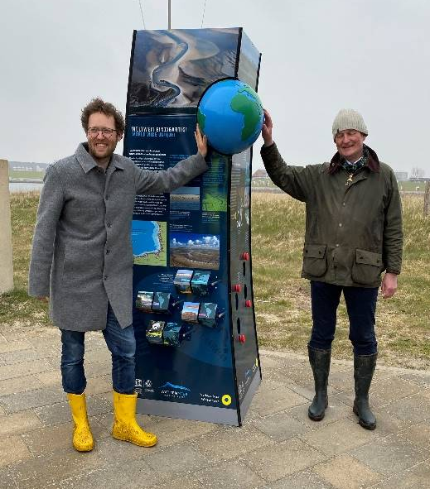
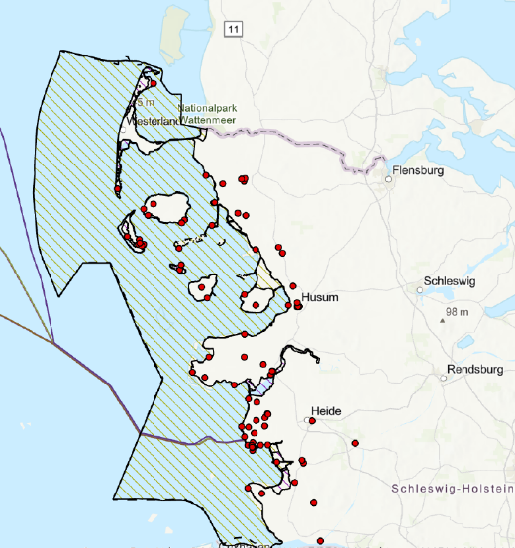
ITI-Project Visualise the Wadden Sea World Heritage
Aim: Increase the visibility of the Wadden Sea UNESCO World Heritage Site in the Schleswig-Holstein National Park region.
Description: World Heritage columns are placed at tourist-relevant locations so that guests and locals can become aware of and learn about the Wadden Sea World Heritage
Actions:
Update 53 of the existing WH-columns
Production of 30 new WH columns
Installing the columns at 83 locations in North Frisia and Dithmarschen
Notes:
ITI Westküste ist ein Element des Operationellen Programms des Europäischen Fonds für regionale Entwicklung des Landes Schleswig-Holstein (EFRE). Förderung läuft über das Wirtschaftsministerium, z.B. für Maßnahmen zum Schutz, zur Förderung und zur Entwicklung des Natur- und Kulturerbes, und zur Vereinbarkeit von Umweltschutz, Ressourcenschonung, Denkmalschutz und Tourismus.
Projektmaßnahmen und -beschreibung:
An touristisch relevanten Standorten und an ausgewählten Zugangsstellen ins WNE (Deich, Strand, Dünen, Badestellen, etc.) werden WNE-Säulen aufgestellt, so dass Gäste und Einheimische auf das WNE aufmerksam werden und sich darüber informieren können.
Umsetzung verschiedener Maßnahmen:
- Aktualisierung vorhandener WNE-Säulen: 53 existierende WNE-Säulen entlang der Küste werden inhaltlich aktualisiert (Überarbeitung nach Vorgaben der trilateralen Strategie für nachhaltigen Tourismus mit der Aufnahme von Dänemark als WNE-Gebiet)
- Produktion von 30 neuen Säulen.
- Aufbau an den vorgesehenen Standorten in Zusammenarbeit mit den 49 Kooperationspartnern – die erste Auslieferung der neuen bzw. aktualisierten Säulen wurde im Frühjahr 2021 begonnen.
Gesamtkosten 220.110 €

Slide 10
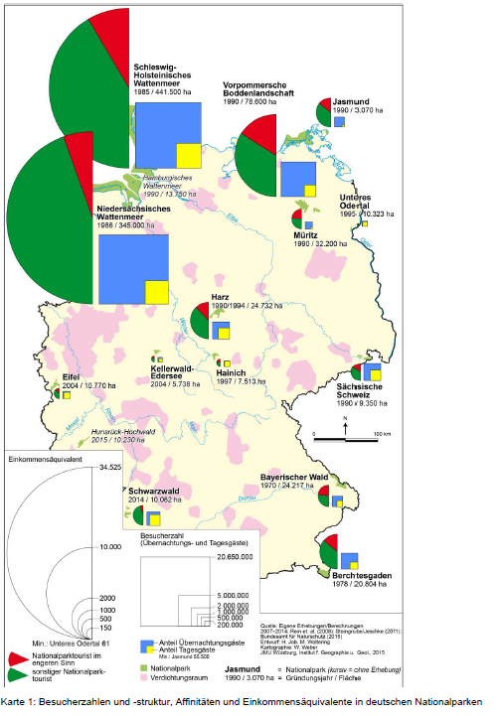

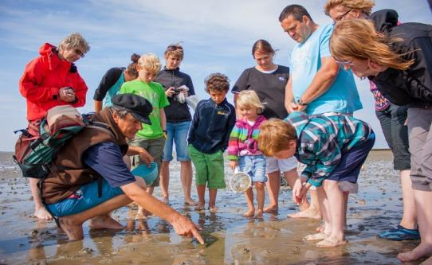
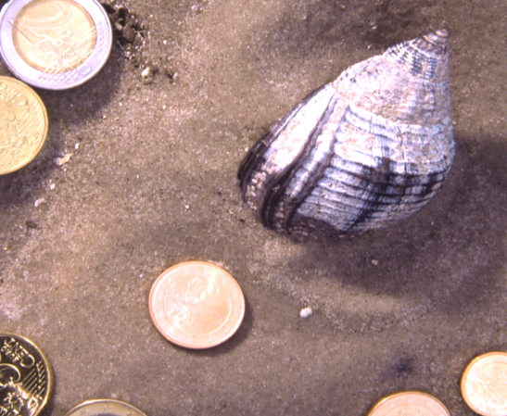
Study
Regional-economic
effects of National Park Tourism in
the Schleswig-Holstein Wadden Sea
(Job, H. et al., 2013)
National Park Tourists
(in the narrow sense): 17,1 %
… generate regional added value
(ie. income) of 89 Mio. Euro
… corresponds to an equivalent of
more than 4.700 full-time jobs
Important for regional economy
and sustainable development
2021/22: Repeating of study!
Aus: Job, H. et al. (2016), BfN-Skripten 431
Notes:
NP Touristen i.e.S, wissen , dass sie sich in einem NP befinden und dieser spielt eine große bzw. sehr große Rolle für den Besuch / die Reisezielwahl.

Slide 11
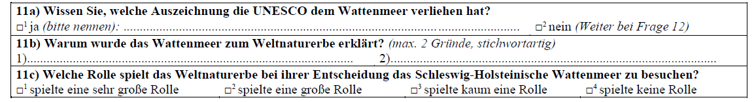
2021/22:
Repeating the study on regional-economic effects, with particular focus on the awareness of tourists to the aspect of World Heritage
and the role it plays when making travel decisions
Study area:
The Wadden Sea regions of Lower Saxony
and Schleswig-Holstein
Countings, face-to-face interviews
14 Locations along National Park SH
All seasons
Extract from questionnaire:
Notes:
NP Touristen i.e.S, wissen , dass sie sich in einem NP befinden und dieser spielt eine große bzw. sehr große Rolle für den Besuch / die Reisezielwahl.

Slide 12
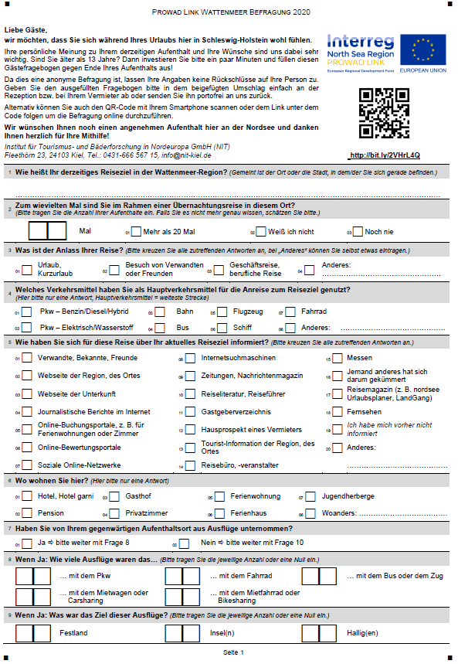
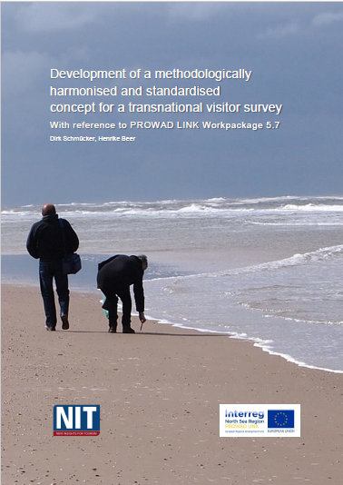
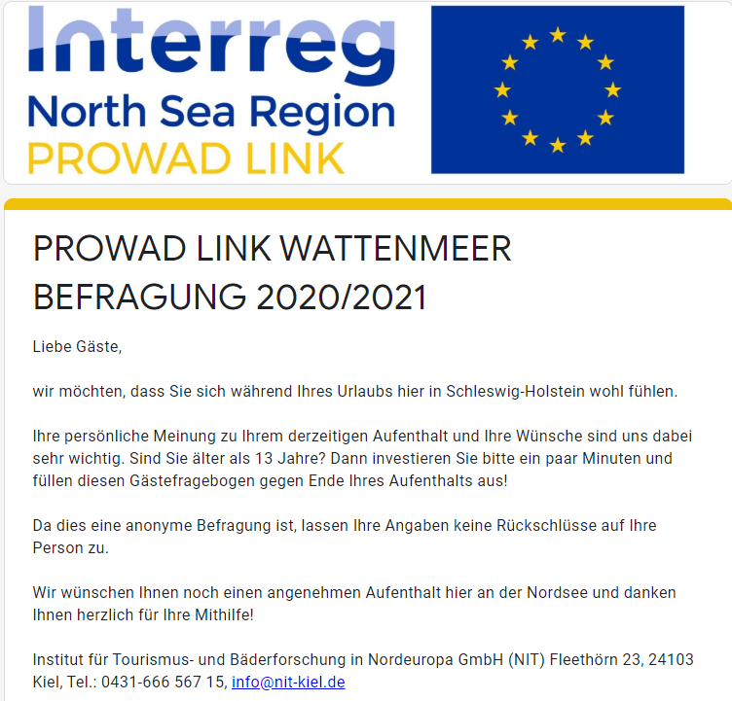
The trilateral visitor survey in DK, D, NL
Notes:
Two studies prior to this in Germany (Lower Saxony and Schleswig-Holstein) in 2013 and 2017

Slide 13

The trilateral visitor survey in DK, D, NL
Start of survey 28. Juni 2020
(delayed due to the pandemic)
End of 2020 survey period 6. November 2020
Restart in spring 2021 1. April 2021
End of survey 2021 31. August 2021
 | SH | LS | DK | NL | Total
Summer, paper-pencil 2020 | 186 | 154 | 122 | 160 | 622
Autumn, paper-pencil 2020 | 90 | 124 | 208 | ? | 422
Spring & summer 2021 | 158 | 158 | 496 | ? | 812
Online (entire survey) | 6 | 3 | - | 461 | 470
SUM | 440 | 439 | 826 | 621 | 2.326
Notes:
Due to Corona first delay and then no spring season for Germany, Denmark and the Netherlands were able to start in April 2021
Germany only in May/June
Therefore 2 more month to gain sufficient data when survey runs in ALL three countries at THE SAME TIME
First numbers regarding response beginning of October
Danish figures still need to be „cleaned“ therefore could drop a little

Slide 14
The residents‘ survey in
Lower Saxony & Schleswig-Holstein
Pilot study with the title “Wadden Sea Nature: Positive effects on the well-being of local residents?”
The Aim to assess the beneficial effects of nature experience in the Wadden Sea World Heritage Area on the health and well-being of local residents
Start of survey October 2021
End of the survey period December 2021
First results January 2022
Telephone interviews calling residents in
7 coastal municipalities in Lower Saxony
2 coastal municipalities in Schleswig-Holstein
n = 600 for each state
Notes:
Beispiel für Fragen/Statements, welche Fragen gestellt werden
Eg: How often residents visit the Wadden Sea
What activities they do (Walking, jogging, bidwatching meeting friends, meditating)
Regarding identity – „The Wadden Sea creates a sense of home in me“
Inspiration – „is a place I go when I need to be inspired“
Relaxation – „ is a place where I relax“, „is a place where I slow down“, „is a place where unwind“
Interpretation will be done by xxxx

Slide 15
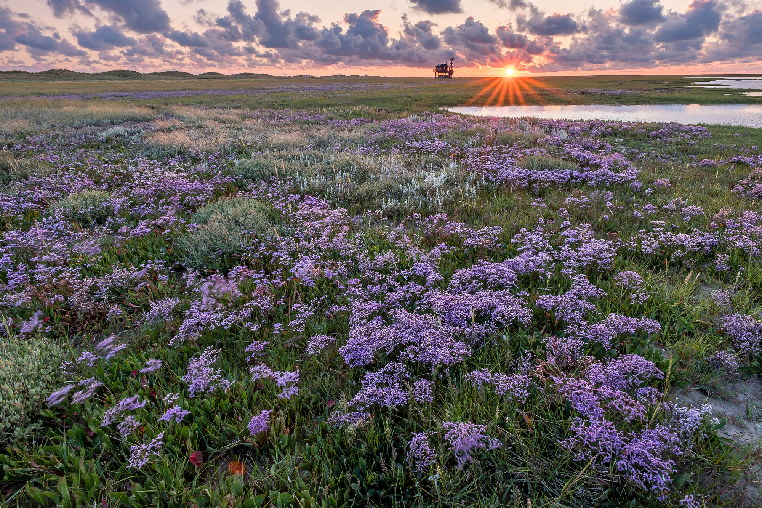

Thank you!

